Slide 1
Advanced, Grade 2, Neuroendocrine Tumor in the Midgut:
Watch and Wait or Initiate Treatment?
Clinical Scenario #1
Jaume Capdevila, MD
Vall d’Hebron University Hospital
Barcelona, Spain
www.prIMEoncology.org

Slide 2

Clinical Scenario #1
40-year-old white Caucasian male
No relevant family history
Previously fit
July 2004: Underwent an abdominal CT scan following trauma experienced in a car accident
  No traumatic organ damage
  However, 2.0 cm mass in terminal ileum plus three liver lesions suspicious for metastases
Endoscopic biopsy of ileum mass
  Grade 2 neuroendocrine tumor
  Ki-67 4%; 3 mitoses per 10 high power fields

Slide 3
Clinical Scenario #1
Additional investigations:
Somatostatin receptor scintigraphy (Octreoscan®)
  Uptake in liver lesions noted
5-HIAA levels and neuron-specific enolase (NSE) within normal range

Slide 4
Q1: What initial treatment would you recommend?
Observation with repeat imaging in 3 months
Resection of primary tumor alone +/- lymph nodes
Resection of primary tumor, lymph nodes and liver metastases
Start medical treatment with somatostatin analogs
Other medical treatment

Slide 5
Clinical Scenario #1
Patient underwent radical resection
  Full recovery and in complete remission
  Lost to follow-up in 2009
In 2014, he presented a renal colic and abdominal ultrasound was performed, showing multiple liver metastases
  Body CT scan identified bilobar liver metastases and mesenteric lymph nodes
  Octreoscan: Uptake in liver and lymph nodes
  (Krenning scale 4)
  No carcinoid syndrome, asymptomatic
  Lab tests within normal range, including liver function, except for CgA 1450 U/L (N<100 U/L)

Slide 6
Q2: What treatment would you now recommend?
Observation with repeat imaging in 3 months
Start medical treatment with a somatostatin analogs
Start chemotherapy
Start a targeted agent (sunitinib or everolimus)
Start with peptide receptor radionuclide therapy (PRRT)

Slide 7
Q3: Would your treatment choice be any different if the patient had clinical evidence of a functioning NET?
Yes
No
Not sure

Slide 8
Parameters With an Impact
on Therapeutic Decision Making
Histology
  Grading grade 1 / grade 2 (NET) vs grade 3 (NEC)
  (WHO 2010)
  Well / moderately or poorly differentiated
  NET / NEC (US)
Hormonal release
  Carcinoid syndrome, insulinoma, gastrinoma, VIPoma
Primary tumor site
  Pancreatic vs intestinal
Somatostatin receptor imaging
Tumor burden / extrahepatic disease
NEC, neuroendocrine carcinoma; NET, neuroendocrine tumor; WHO, World Health Organization

Slide 9
Locoregional Treatments in Metastatic Setting
  Radical surgery of primary tumor and metastases is recommended when R0 can be achieved
  No data of adjuvant therapy are available in this setting
  Locoregional liver therapies (radiofrequency ablation, hepatic artery (chemo)embolization) could be a treatment option based on tumor size, anatomical location, number of metastases and presence of extrahepatic disease

Slide 10
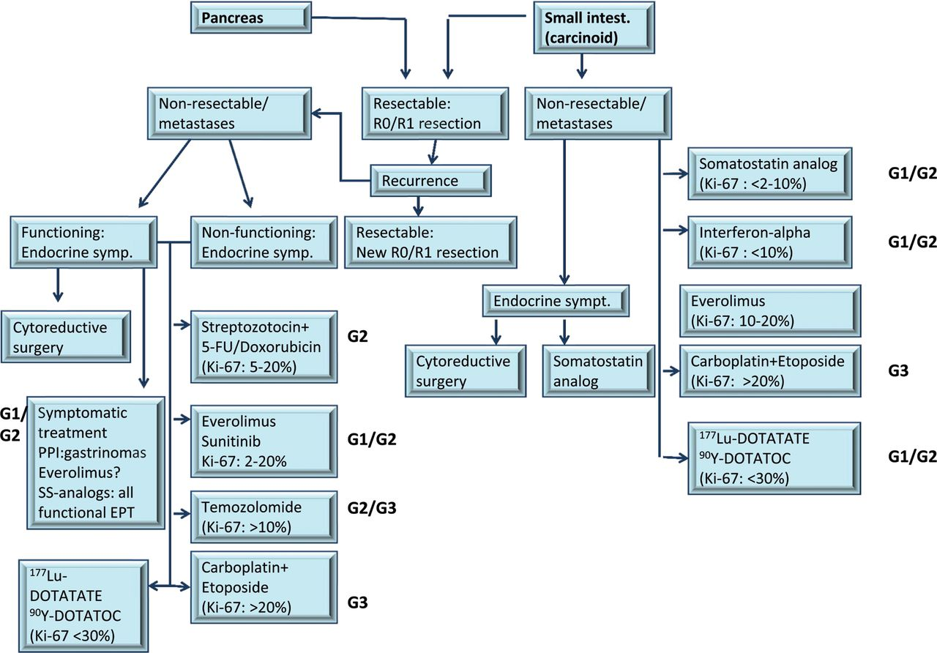
Systemic Therapy: How Guidelines Could Help Us
Öberg K, et al. Ann Oncol. 2012;23 Suppl 7:vii124-130

Slide 11
Systemic Therapy: How Guidelines Could Help Us
If complete
resection possible
Resect primary + metastases
Locoregional
unresectable
disease and/or
distant metastases
Imaging:
  Multiphasic CT
  or MRI
  Consider somatostatin scintigraphy
Consider 24-hour
urine 5-HIAA
Consider chromogranin A (category 3)
Observe with markers and scans every 3-12 months or
octreotide
Asymptomatic,
low tumor burden
Clinically
significant
progressive disease
Locally symptomatic from primary tumor
Consider resection of primary tumor
Clinically
significant
tumor burden
Octreotide
Carcinoid
syndrome
Octreotide
Echocardiogram
National Comprehensive Cancer Network. NCCN Clinical Practice Guidelines in Oncology. Available at http://www.nccn.org/professionals/physician_gls/f_guidelines.asp. Accessed: September 22, 2014.

Slide 12
Systemic Therapy:
How Guidelines Could Help Us
NET
grade 1/ grade 2
Functional NET
Grade 1
Low tumor burden
+/- PD
Non-functional NET
SSA
IFN-α
Wait & See
Grade 1 / LOW grade 2
High tumor burden
HIGH grade 2
Locoregional treatment
PD
Chemo
Loco-regional Tx;
SSA
(IFN-α)
SSA
PD
Debulking; RFA
PD
PD
Everolimus
PRRT
PD, progressive disease; SSA, somatostatin analog; IFN, interferon; RFA, radiofrequency ablation
Adapted from Pavel M, et al. Neuroendocrinology. 2012;95(2):157-176.

Slide 13
Chemotherapy:
Limited Role in Enteric NETs
Treatment | Author | Histology | No. | ORR, % | Median survival
Doxorubicin | Engstrom [53] | Carcinoid | 81 | 21 | 12
DTIC | Bukowski [54] | Carcinoid | 63 | 16 | 20
Paclitaxel | Ansell [55] | Carcinoid | 24 | 8 | 18
Docetaxel | Kulke [56] | Carcinoid | 21 | 0 | 24
Gemcitabine | Kulke [57] | Carcinoid | 18 | 0 | 11.5
Topotecan | Ansell [58] | Carcinoid | 22 | 0 | 22
Temozolomide | Ekeblad [59] | Pancreatic NET | 12 | 8 | 7
Pemetrexed | Chan [60] | Pancreatic and carcinoid | 17 | 6 | 12.1
Grande E, et al. Clin Transl Oncol. 2010;12(7):481-492.

Slide 14
Molecular Targeted Therapies in Extrapancreatic NETs
Patients with advanced NET and a history of secretory symptoms (N = 429)
  Advanced low- or intermediate-grade NET
  Radiologic progression ≤12 months
  History of secretory symptoms (flushing, diarrhea)
  Prior antitumour therapy allowed
  WHO PS ≤2
Everolimus 10 mg/day +
Octreotide LAR 30 mg/28 days
n = 216
R
A
N
D
O
M
I
Z
E
1:1
Crossover allowed at
time of PD
Treatment
until disease progression
Placebo +
Octreotide LAR 30 mg/28 days
n = 213
Multiphasic CT or MRI performed every 12 weeks
Primary Endpoint:
PFS
Statistical boundary = .0246
Secondary Endpoints:
OS
ORR
Biomarkers
Safety
PK
Enrollment January 2007-March 2008
PD, progressive disease; ORR, overall response rate; PK, pharmacokinetics
Pavel M, et al. Lancet. 2011;378(9808):2005-2012.

Slide 15

RADIANT-2: Border-Line Negative Trial
100
Kaplan-Meier median PFS
Everolimus + octreotide LAR: 16.4 months
Placebo + octreotide LAR: 11.3 months
Hazard ratio = 0.77; 95% CI [0.591.00]
P value = .026
80
60
Percentage Event-Free
40
Total events = 223
Censoring times
Everolimus + octreotide LAR (n/N = 103/216)
Placebo + octreotide LAR (n/N = 120/213)
20
0
0
2
4
6
8
10
12
14
16
18
20
22
24
26
28
30
32
34
36
38
Time, months
123 placebo + octreotide LAR patients crossed over at the time of progression
Pavel M, et al. Lancet. 2011;378(9808):2005-2012.

Slide 16
Ongoing Phase III Clinical Trials in Extrapancreatic NETs
RADIANT-4
  Nonfunctioning gastrointestinal and lung grade 1 / grade 2 NETs
  Documented disease progression
  Everolimus vs placebo
SWOG0518
  Octreotide + bevacizumab vs octreotide + IFNα
  Grade 2 small intestine NETs in prior disease progression
NETTER-1
  Lutetium + octreotide vs octreotide
  Grade 1 / grade 2 small intestine in progression after somatostatin analog (SSA)

Slide 17
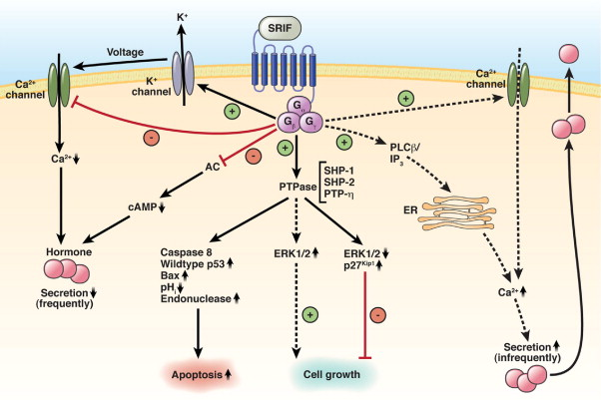

Antiproliferative Effect of SSA in NETs
Öberg KE, et al. Gastroenterology. 2010;139(3):742-753.

Slide 18
Prospective Trials of SSA in Small Intestine NETs
Placebo-Controlled, Double-Blind, Prospective, Randomized Study on the Effect of Octreotide LAR in the Control of Tumor Growth in Patients With Metastatic Neuroendocrine MIDgut tumors: A Report From the PROMID Study Group
Phase III, randomized, double-blind, placebo-controlled
18 centers in Germany (2001–2008)
Octreotide LAR
30 mg im
every 28 days
Patients with midgut NETs
Treatment-naïve
Histologically confirmed
Locally inoperable
or metastatic
Well-differentiated
Measurable (CT/MRI)
Functioning or non-functioning
Treatment until CT/MRI documented tumor progression or death
RANDOMIZATION (1:1)
Placebo im
every 28 days
Rinke A, et al. J Clin Oncol. 2009;27(28):4656-4663.

Slide 19

PROMID Study: Grade 1 and Low Liver Involvement Small Intestine NETs
 | Octreotide LAR n = 42 | Placebo n = 43
Median age, years (range) | 63.5 (38-79) | 61.0 (39-82)
Carcinoid syndrome (%) | 40.5 | 37.2
Hepatic tumor load 0% 0% - 10% 10% - 25% 25% - 50% >50% | 16.7 59.5 7.1 11.9 4.8 | 11.6 62.8 4.7 9.3 11.6
Octreoscan positive (%) | 76.2 | 72.1
Ki-67 up to 2% (%) | 97.6 | 93.0
1.0
Placebo, 40 events; median, 6.0 months
Octreotide LAR, 26 events; median, 14.3 months
0.8
0.6
0.4
0.2
Rinke A, et al. J Clin Oncol. 2009;27(28):4656-4663.
0
6
12
18
24
30
36
42
48
54
60
66
72
78

Slide 20
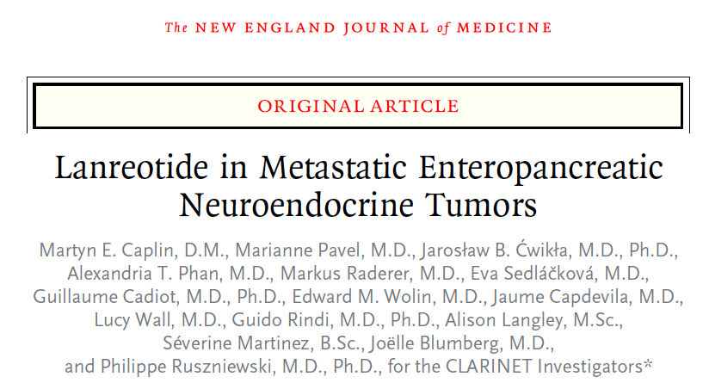
Nonfunctional
Nonprogressive
Enteropancreatic
G1/G2 (Ki67<10%)
Caplin ME, et al. N Engl J Med. 2014;371(3):224-233.

Slide 21

CLARINET Study -
Progression-Free Survival (PFS)
100
90
Lanreotide 120 mg
32 events, 101 patients
Median not reached
80
70
60
50
Placebo
60 events, 103 patients
Median, 18.0 months (95% CI, 12.1-24.0)
40
30
20
P<.001 for the comparison of PFS
Hazard ratio for progression or death, 0.47 (95% CI, 0.30-0.73)
10
0
0
3
6
9
12
18
24
27
Months
Caplin ME, et al. N Engl J Med. 2014;371(3):224-233.

Slide 22
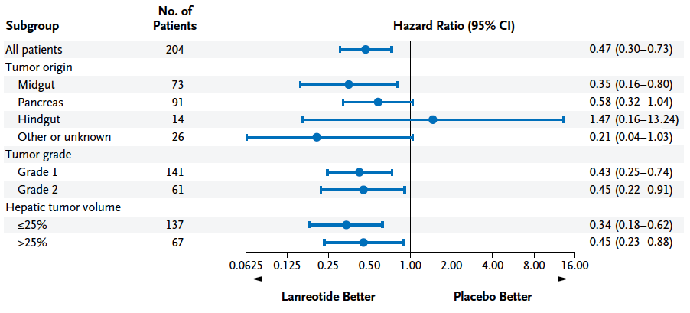
CLARINET: Increase PFS in Grade 1 /
Grade 2, High Liver Involvement, Enteropancreatic NETs
Caplin ME, et al. N Engl J Med. 2014;371(3):224-233.

Slide 23
Evidence-Based Treatment Decisions
Radical surgery for the primary and all metastatic sites suggests increases survival
Disease progression status is not always easy or feasible to assess
Phase III clinical trials with targeted agents include populations with documented disease progression
The CLARINET study results challenge the traditional wait & see policy

Slide 24


THANK YOU FOR YOUR ATTENTION
jacapdevila@vhebron.net jcapdevila@onco.cat

